Slide 1
Students’ Academic Performance

Slide 2
The dataset about students' academic performance, consists of 480 student records and 16 features. The features are classified into three major categories:
Demographic features such as gender and nationality.
Academic background features such as educational stage, grade Level and section.
Behavioral features such as raised hand on class, opening resources, answering survey by parents, and school satisfaction.

Slide 3
The dataset consists of 305 males and 175 females, and the students come from different origins. The dataset is collected through two educational semesters: the first and second semesters.

Slide 4
The data set includes also:
The school attendance feature such as the students are classified into two categories based on their absence days: students exceed 7 absence days and students absence days under 7.
Parent parturition in the educational process. The parent participation features have two sub-features: Parent Answering Survey and Parent School Satisfaction.

Slide 5
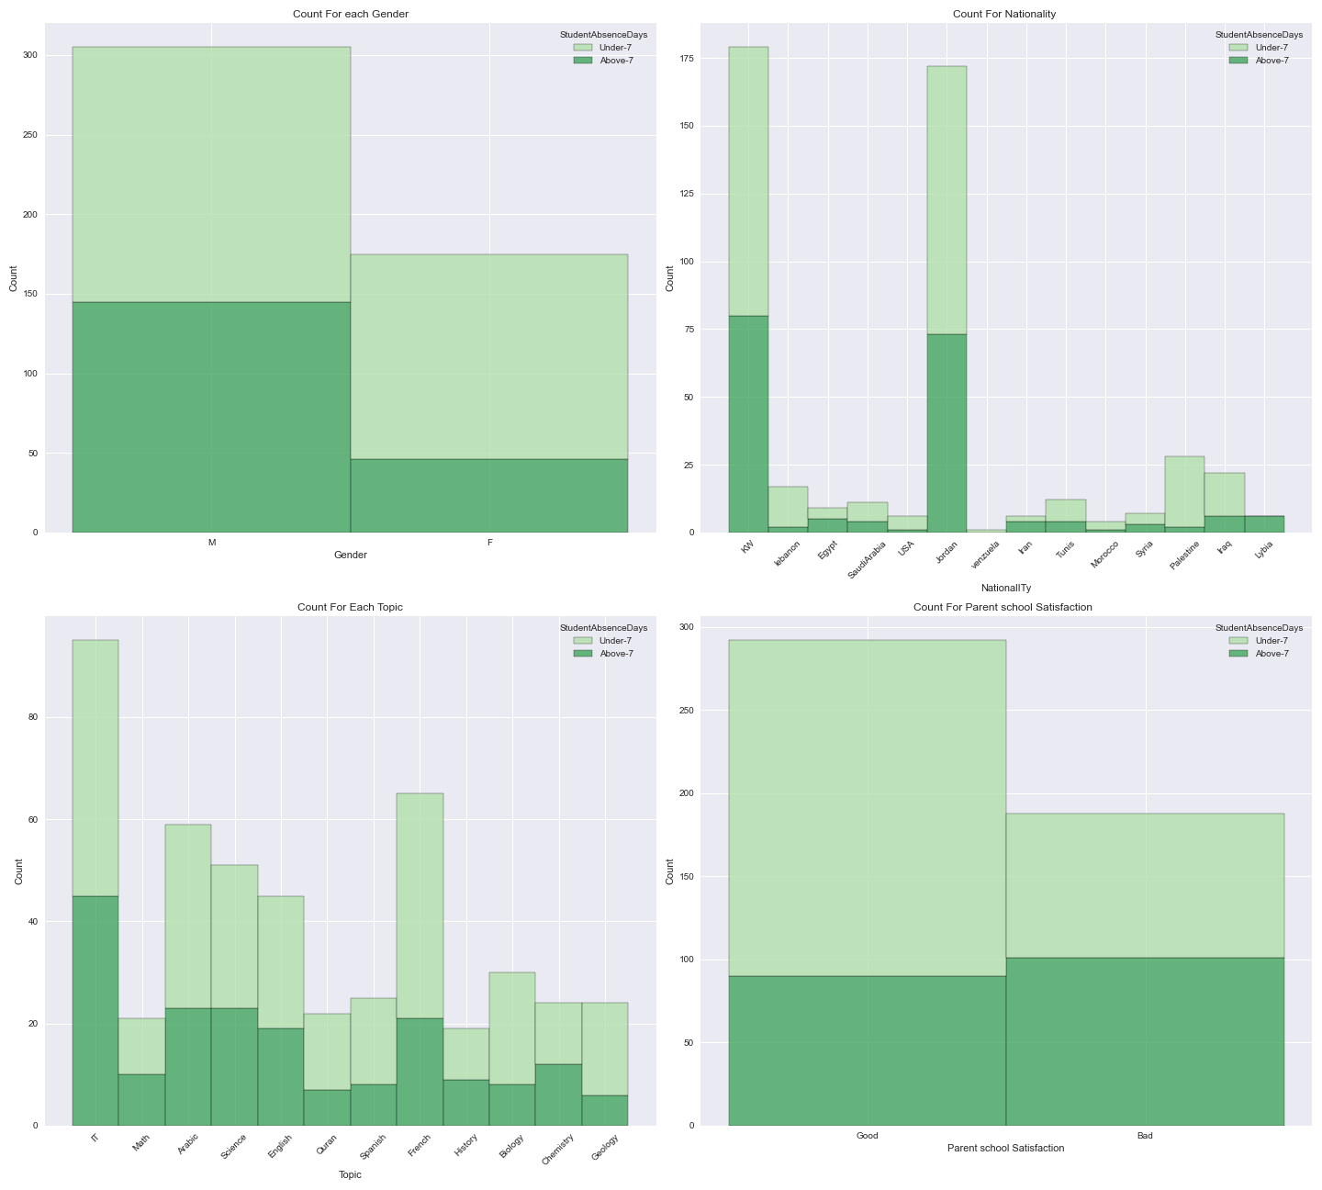
The First Figure

Slide 6
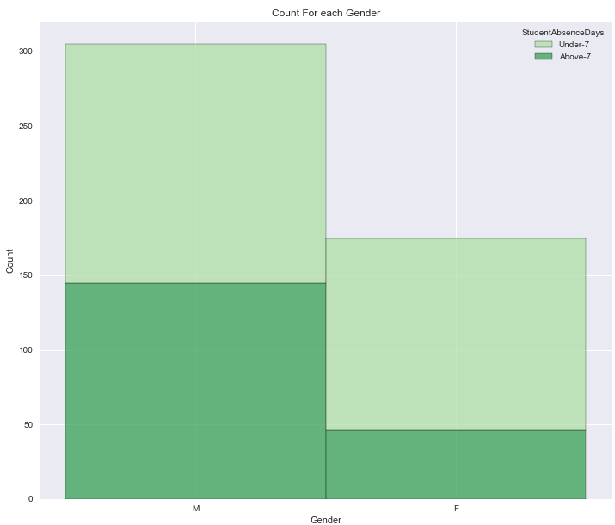
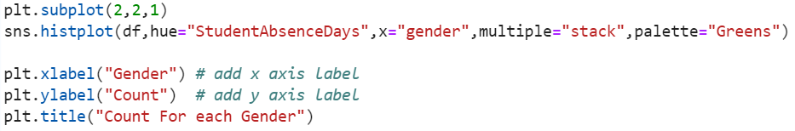
The percentage of males absence above 7 days are higher than females.
We have an almost 2 to 1 ratio of males to females in the data set.

Slide 7
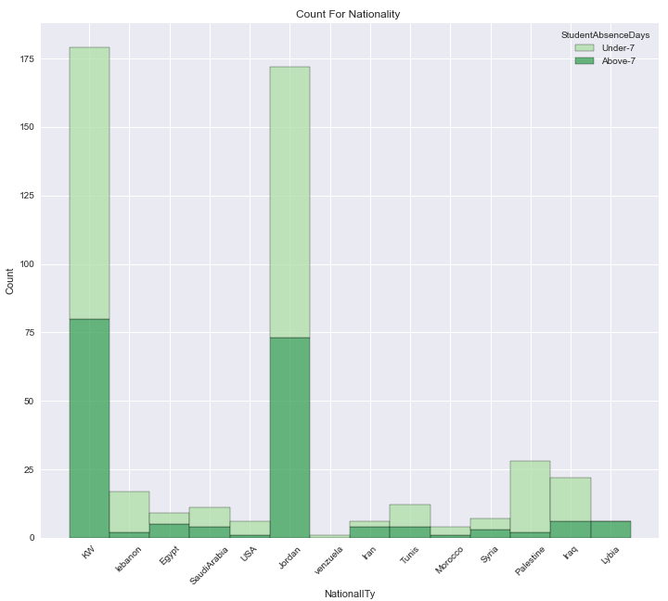
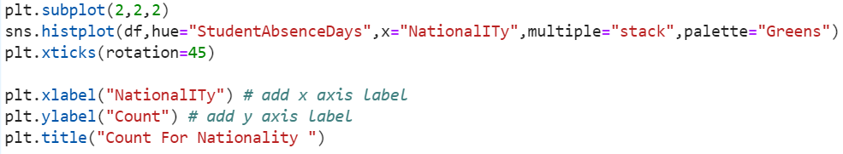
Most of the data are from Jordan and Kuwait.
Palestine and Lebanaon have a low absence percentage.
Kuwait and Jordan have almost the same percentages.

Slide 8
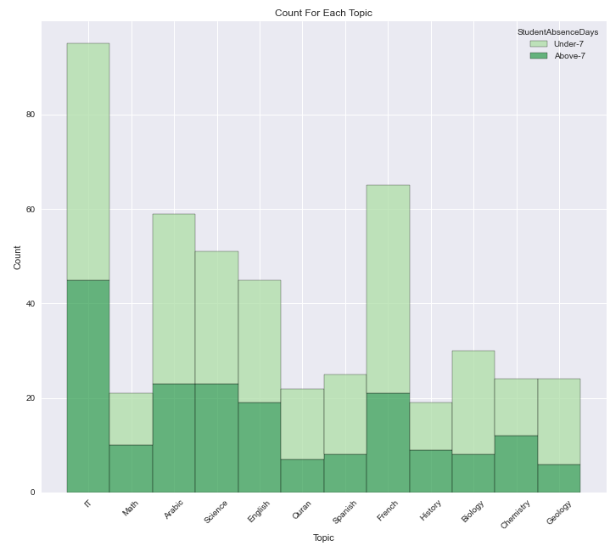
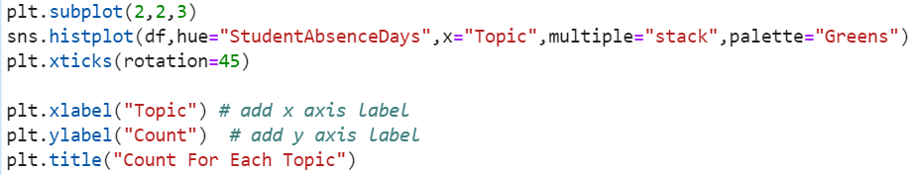
The topic is neutral in term of absence.
Most of the topics have identical rates.

Slide 9
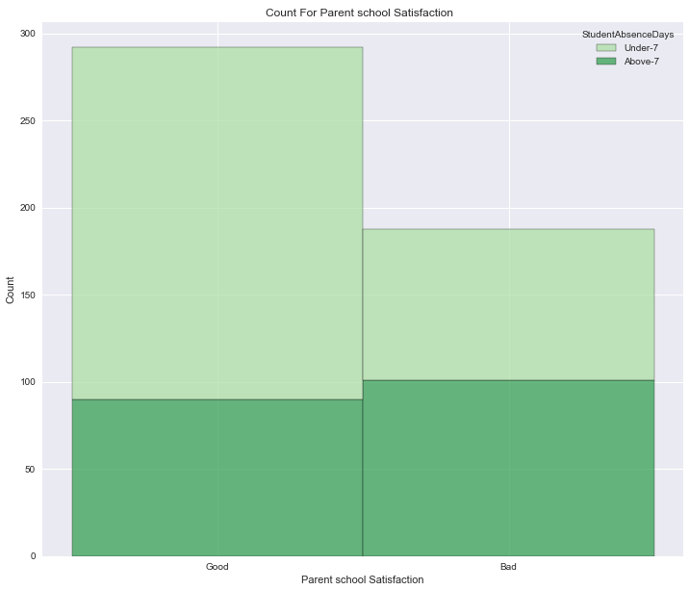
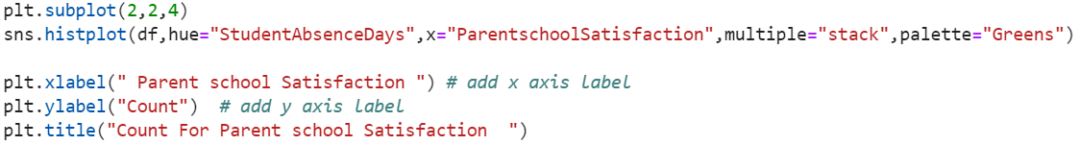
The higher your parents are satisfied with the school the lower your absence days will have.

Slide 10
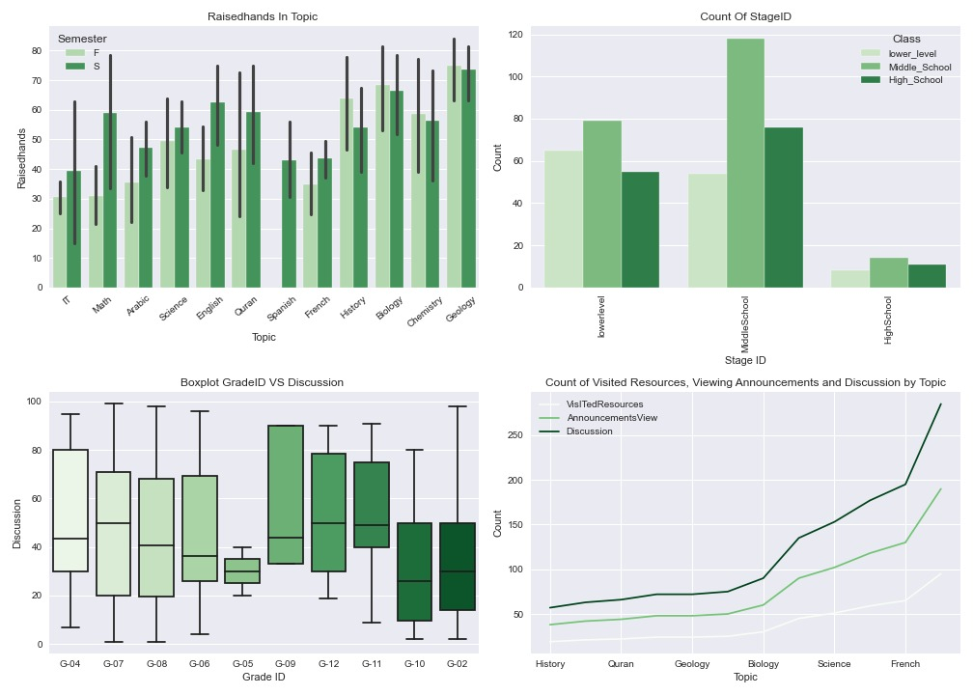
The Second Figure

Slide 11
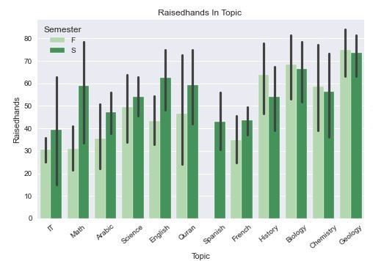
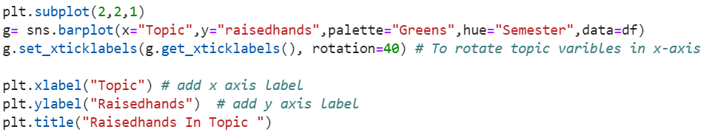
Geology is the highest topic in the count of students who raises a hand in class in the two semesters. And IT is the lowest topic.
Spanish has not had students who raise a hand in class in the first semester.
Quran and IT have the highest mean, Quran in the first semester and IT in the second semester.

Slide 12
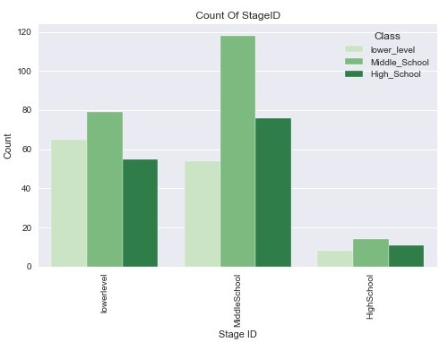
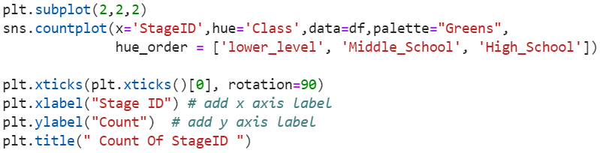
The middle school is the highest stage, then lower school and the lowest stage is high school.

Slide 13
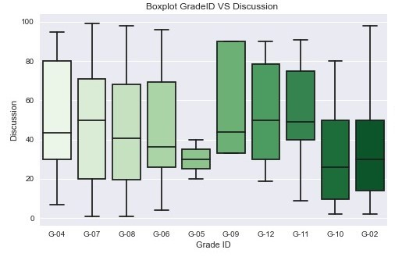
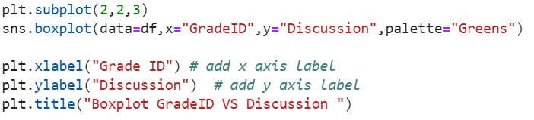
Grade-07 has the maximum value, grade-07 and grade-08 have the minimum values.
Grade-07 has the maximum median.
There are no outliers.

Slide 14
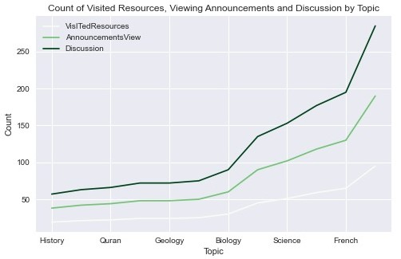
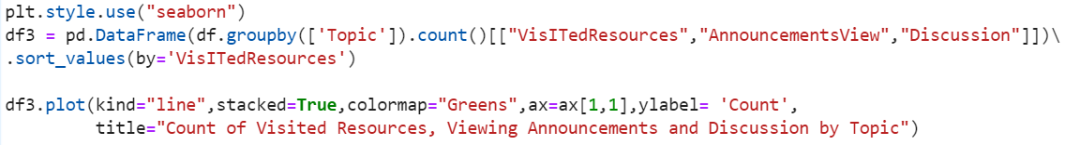
The discussion is higher than visited resources and viewing announcements.
The visited resources is lower than discussion and viewing announcements.
French is the highest topic and history is the lowest topic.

Slide 15
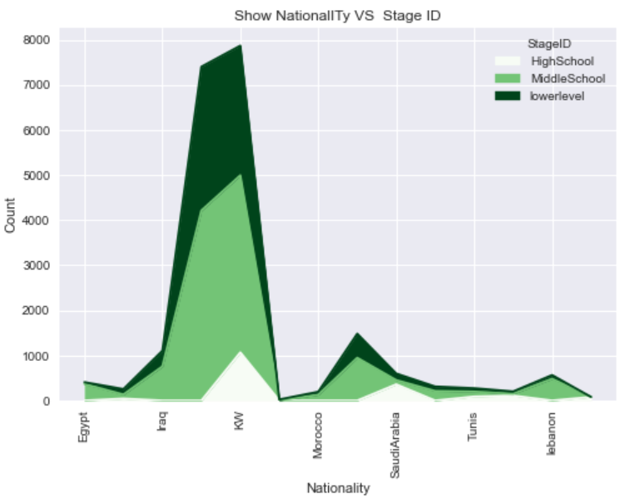
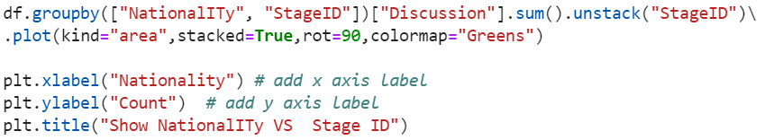
Kuwait has the maximum count for each stage.
The lower-level stage appears higher in Kuwait.

Slide 16
Thank you for listening
Ruba Alkhattabi
Amani Almarzoog
Abdullah Alothman
Razan Alsallumi

